Slide 1
SUBSET- SUM PROBLEM OF A GIVEN SET USING BACKTRACKING
Presented by:
Dr.V. S. Rajpurohit
Mrs. Sudha. H .Ayatti.

Slide 2
Problem Definition:
To implement subset sum problem using backtracking
In c language.
CSE@GIT

Slide 3
Objectives of the Experiment:
To introduce the concept of backtracking.
Present the working of subset - sum problem.
To find the subsets as a solution for a given positive integer.
Analyze the Algorithm Complexity.

Slide 4
BACKTRACKING
Suppose you have to make a series of decisions, among various choices, where You don’t have enough information to know what to choose.
Each decision leads to a new set of choices.
Some sequence of choices (possibly more than one) may be a solution to your problem.
Backtracking is a methodical way of trying out various sequences of decisions, until you find one that “works”

Slide 5
Backtracking - Examples
8 Queen Problem
Graph Coloring
Sum of Subset
Hamiltonian Cycle
Travelling Salesman Problem (TSP)
Permutation & Combination Generation

Slide 6
Theoretical Background
Backtracking provides the hope to solve some problem instances of nontrivial sizes by pruning non-promising branches of the state-space tree.
The success of backtracking varies from problem to problem and from instance to instance.
Backtracking possibly generates all possible candidates in an exponentially growing state-space tree.

Slide 7
Theoretical Background
Each non-leaf node in a tree is a parent of one or more other nodes (its children)
Each node in the tree, other than the root, has exactly one parent
parent
parent
children
children

Slide 8
Backtracking – Terminology
A tree is composed of nodes
The (one) root node
Internal nodes
Leaf nodes

Slide 9
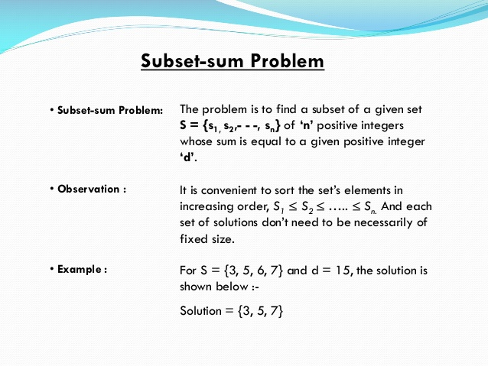
Theoretical Background:

Slide 10
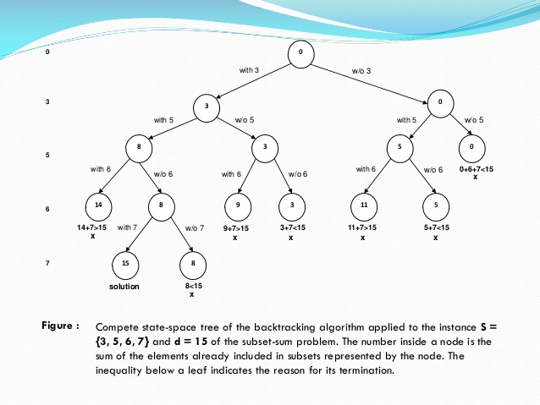
Space –tree for the given set s={3,5,6,7} with d=15

Slide 11


Let w1,w2,w3…….wn be n positive numbers
x1,x2,x3……….xn be solution vector(subset)
Xi = 1 if wi is chosen
Xi =0 if wi is not chosen
MATHEMATICAL REPRESENTATION
Total sum till now still there
Thus, Cannot lead to solution…..

Slide 12



MATHEMATICAL REPRESENTATION

Slide 13
STATE SPACE TREE – W={2,3,4,5} m= 7
0
2
0
2
3
0
5
X
6
2
7
3
5
9
S
X
X
11
6
7
2
8
3
X
X
S
X
X
X

Slide 14
ALGORITHM
//Implements subset sum problem
//Input: S[ 1….n] set of n numbers and sum value
//Output: All possible subsets for the given sum integer
// k – index of elements
// s- partial sum of subset
// r- sum of all elements in S

Slide 15
ALGORITHM
Algorithm SumOfSub(s,k,r)
{
X[k] =1; // creating left child with kth element
If (s+w[k]==m)
then
write (x[1:k]) // subset found
// There is no recursive call here…..
else
if (s+w[k]+w[k+1] ≤ m)
then
SumOfSub (s+w[k], k+1,r-w[k])
// create right child without kth element
If((s+r-w[k])≥m) && (s+w[k+1]≤m))
then{
X[k] : =0;
SumOfSub(s, k+1, r-w[k]);
}
} Time Complexity: O(2^{n})

Slide 16
Example
Say that our weight values are 5, 3, 2, 4, 1
• d is 8
• We could have
– 5 + 3
– 5 + 2 + 1
– 4 + 3 + 1
• We want to find a sequence of values that satisfies the criteria of adding up to d

Slide 17
Sample Output
Enter the maximum number of elements : 5
Enter the weights of the elements :
1 2 3 4 5
Enter the total required weight : 5
SOLUTION #1 IS
{ 1 4 }
SOLUTION #2 IS
{ 2 3 }
SOLUTION #3 IS
{ 5 }
The above-mentioned sets are the required solution to the given instance.
SAMPLE 2
Enter the maximum number of elements : 4
Enter the weights of the elements :
1 2 3 4
Enter the total required weight : 11
The given problem instance doesnt have any solution.

Slide 18
Illustration of the All-Pair Shortest Path Algorithm
Animated video

Slide 19
Learning Outcome of the Experiment and Conclusion
At the end of the session, students should be able to :
Explain the concept of Backtracking [L2, CO 3, PO3]
Demonstrate the working of subset sum problem
[L3, CO 2,3, PO3]
Estimate all subsets for the given integer value
[L5, CO 2, PO3,4]

Slide 20
THANK YOU…..

